Slide 1
Hotel Management System 2

Slide 2
Booking a Room

Slide 3
What are the steps to booking a room?

Slide 4
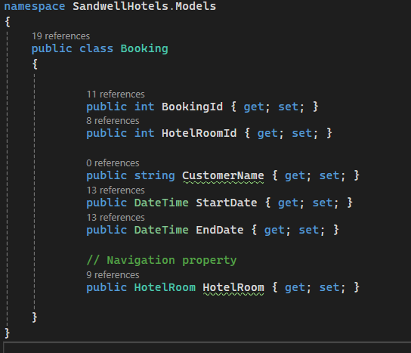
First, we must create a Booking model
The model has two very important fields
The HotelRoomID which creates a link between the tables
Then the HotelRoom Navigation property which allows the connection to carry all the details over

Slide 5
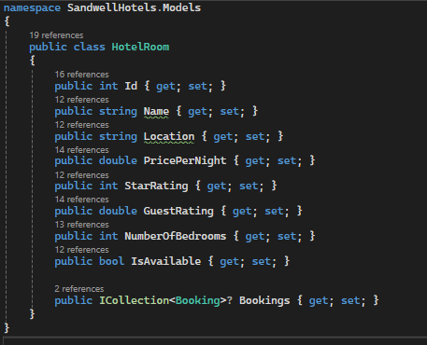
Now we update the original HotelRoom Model
We have added the Bookings to each hotel room.
This makes it so that each hotel room know which booking it is linked to.

Slide 6
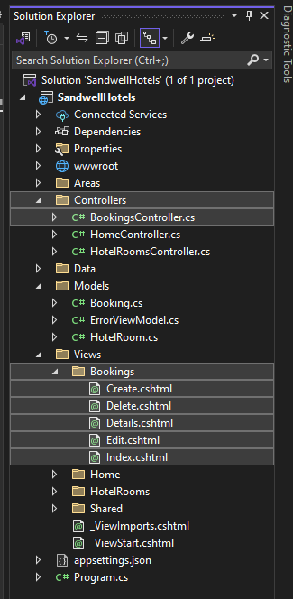
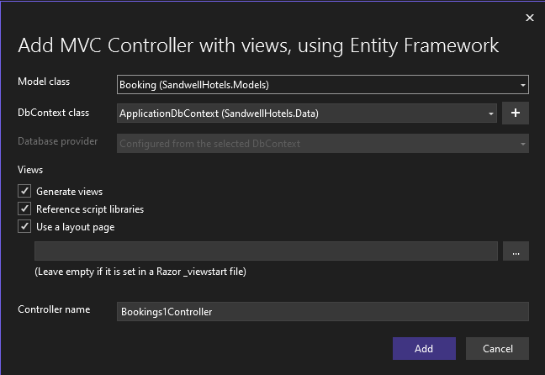
Scaffold Controller with Views

Slide 7
Editing the logic of booking a hotel room

Slide 8

First, we will add a "Book" button to the hotel room Index Page
We add a new <a> tag to each row in the Index page for the Hotel Rooms to allow us to hit the endpoint to book that hotel room

Slide 9
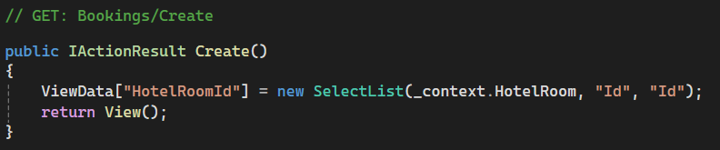
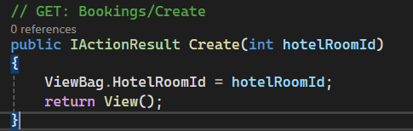
Now we edit the Create Get Method in the Bookings Controller
Instead of passing all of the Hotel Room ID's back, we only pass through the selected room ID, when they selected the button

Slide 10
Now we edit the Create Form in the View
Instead of allowing the user to pick or enter in a Hotel Room ID, we have the one we passed through hidden in the form

Slide 11
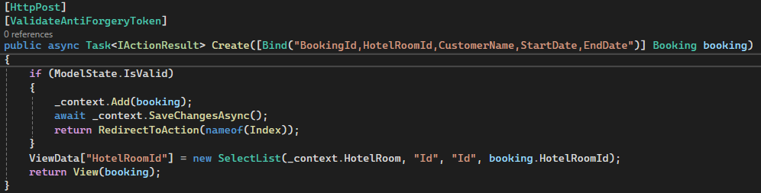
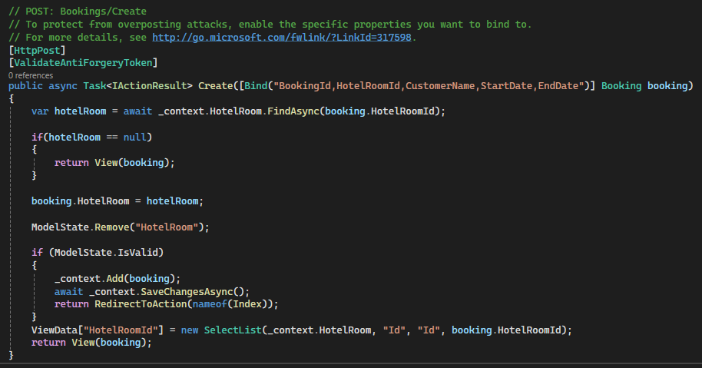
Editing the Controller Create Post Endpoint Method
We first find the hotel room they have selected and store it in a variable called "hotelRoom".
We make sure it is not null.
Then we assign the hotel room they booked in the booking variable.
Then we remove Hotel Room from the ModelState, to allow us to pass through the booking.
Rest remains the same

Slide 12
Try to Book a Hotel Room

Slide 13
Let's think about only allowing them to make the booking if the hotel room is available

